Slide 1


UX Checklist Infographics
UXD
Mike Martel
2019-06-13
[4665] Create infographics for UX Checklist
Digital Collaboration Division, Chief Information Officer Branch
Treasury Board of Canada Secretariat / Government of Canada
Division de la collaboration numérique, Direction du dirigeant principal de l’information
Secrétariat du Conseil du Trésor du Canada / Gouvernement du Canada

Slide 2
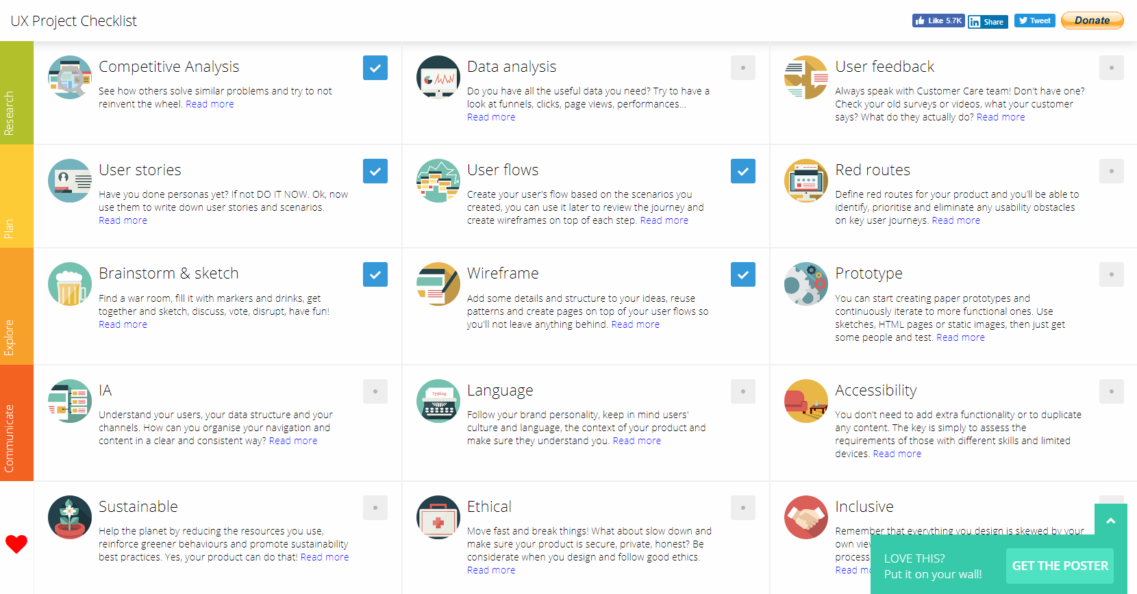

UX Checklist – infographic
An early requirement of the UX checklist was that the checklist could be used as a guide to help piece together a solution.
A main infographic could be created that covers all the tasks or steps the team agreed upon
Examining
Define problem statement for application / feature (5 points)
Lead: Product Owner
Contributors: Management, Project Team
Approval: Product Owner
Artifacts: Project Scope Document
Competitive analysis or literature review including exploring open source options (8 points)
Lead: Research, Development
Contributors: Project Team
Artifacts: Competitive analysis report OR Evaluation of possible open-source solution
Define business requirements, technical requirements, dependencies and project scope (24 points)
Lead: Product Owner
Contributors: Project Team
Artifacts: Business Requirements, Technical Requirements, How it will fit into the ecosystem of the OADW
Develop project plan (20 points)
Lead: Research
Artifacts: Product Roadmap, Research plan, Time to Market, Epic in Zube with related tasks
Conduct initial user research (20 points)
Lead: Research
Activities: user interviews, journey mapping sessions, online surveys
Analysis and report on user research (40 points)
Lead: Research
Artifacts: personas, journey maps, experience map, user interview report, thematic mind map, qualitative data from help desk, quantitative data from current platforms,
Define user requirements (5 points)
Lead: Product Owner
Contributors: Research
Artifacts: User requirements (included in Project Scope document)
Drafting
Develop user stories (8 points)
Lead: Research
Contributors: Design, reps from all teams
Artifacts: user stories, red routes, use cases, user scenarios
Create user task flows (20 points)
Lead: Design
Contributors: Content, Research, Development
Artifacts: task flows, user flows,
Information architecture / content design (13 points)
Lead: Content
Contributors: Design, Development and Research
Artifacts: site map,
Development: can start back-end schema
User research on content design and IA (13 points each)
Lead: Research
Contributors: Content
Artifacts: Treejack testing, card sort testing
Analysis on IA research (8 points)
Lead: Research and Content
Artifacts: research report with summary of findings and recommendations
Blueprinting Content / application layout (8 points)
Lead: Design
Contributors: Content, Development
Artifacts: low-fidelity wireframes (paper, whiteboard or Illustrator), basic draft copy, identifying placement of text
Development: can start front-end development
Create wireflows (optional) (8 points)
Lead: Design
Contributors: Content
Match task flows with low fidelity wireframes
User interface design (v1) (8 points)
Lead: Design
Contributors: Content, Development
Artifacts: low-mid fidelity wireframe (XD, Illustrator),
User interface design with changes based on first iteration. (v2) (13 points)
Lead: Design
Contributors: Content, Development
Artifacts: mid-high fidelity wireframe
User research on interface design (8 points)
Lead: Research
Contributors: Design
Artifacts: first click test, task-analysis test, A/B test
Analysis on interface design research (8 points)
Lead: Research
Contributors: Design
Artifacts: A/B, first-click or task-analysis report
User interface design with changes based on user research and clickable interactions. (v3) (13 points)
Lead: Design
Contributors: Research
Artifacts: high fidelity wireframe with clickable interactions
Building
Write and translate copy for first coded prototype (13 points)
Lead: Content
Contributors: Design, Development
Artifacts: Word document with translated copy, provided to front-end developers
Add dummy content to developed prototype (8 points)
Lead: Content or Development
Contributors Involved: Design
Artifacts: dummy content to populate alpha version of app
Provide MVP deliverable (coded prototype) (Devs to evaluate effort required)
Validation and Revisiting
Quality assurance (8 points)
Lead: QA Specialist
Contributors: Development, Content
Artifacts: QA report
Usability and accessibility testing (points vary 40+)
Lead: Research
Contributors: Design, Development
Artifacts: accessibility review, task-analysis test, first-click test, usability test
Analyze usability testing (20 points)
Lead: Research
Contributors: Design, Development
Artifacts: research report(s) with summary of findings and recommendations
Next Steps: Identify new features and improvements for future iterations
“What are we working on next?”. Defining new problem statements (start process over) This can be identified using information from previous steps.
Lead: product owner
Contributors: Project team
Artifact: new problem statement

Slide 3
UX Checklist – complimentary game cards
A complimentary series of info graphic cards could be created to facilitate the scoping of UX work required to piece together a particular solution similar to how cards are played in sprint poker

Slide 4
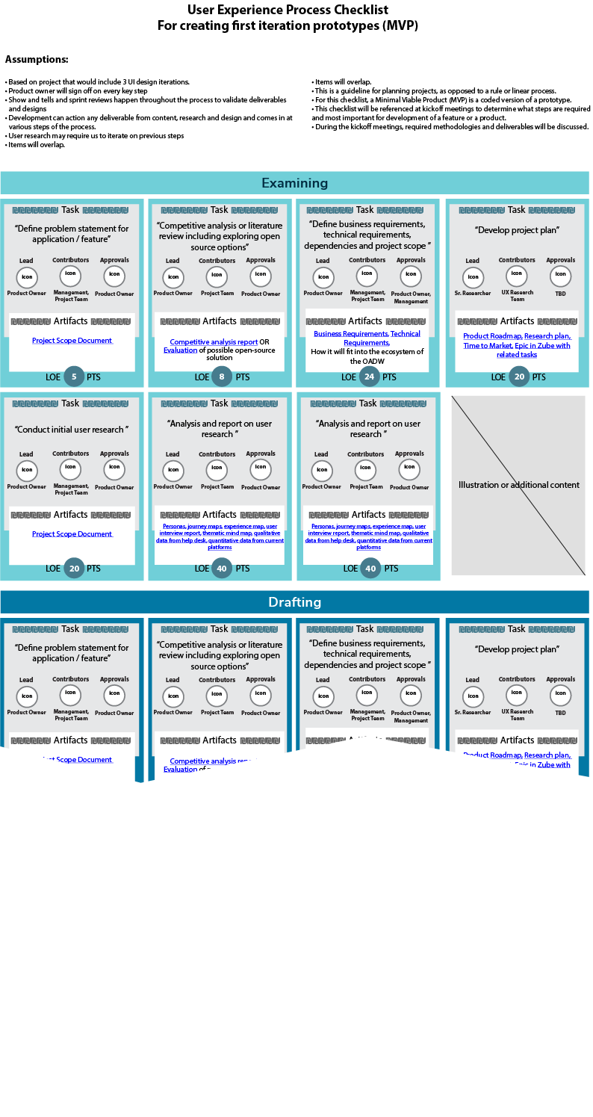
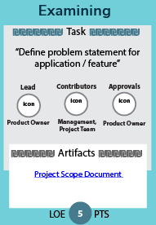
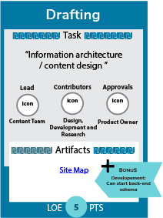
UX Checklist Infographic wireframe & game cards

Slide 5


Discussion: send me additional requirements/ideas via message

Slide 6
Thank you/Merci !

